Slide 1
Clustering Results for Only Failed Units (without normalization)
7 Clusters
cluster 0: number of failed = 44 out of 227, Percentage = 19.38 %
cluster 1: number of failed = 24 out of 227, Percentage = 10.57 %
cluster 2: number of failed = 33 out of 227, Percentage = 14.53 %
cluster 3: number of failed = 14 out of 227, Percentage = 6.16 %
cluster 4: number of failed = 28 out of 227, Percentage = 12.33 %
cluster 5: number of failed = 40 out of 227, Percentage = 17.62 %
cluster 6: number of failed = 44 out of 227, Percentage = 19.38 %
 | Cluster 0 Center | Cluster 1 Center | Cluster 2 Center | Cluster 3 Center | Cluster 4 Center | Cluster 5 Center | Cluster 6 Center
Ith | 16.4071 | 16.8699 | 16.7764 | 17.1199 | 17.7800 | 16.7161 | 17.3706
Slopeff | 0.1999 | 0.1633 | 0.1750 | 0.1557 | 0.2108 | 0.1928 | 0.1773
Chirp | 352.3705 | 349.4904 | 351.8970 | 349.4150 | 351.7029 | 345.1935 | 355.8127
WaveLen | 1551.4698 | 1554.1300 | 1552.1597 | 1553.3074 | 1553.0282 | 1552.8589 | 1553.2725
SMSR | 35.0152 | 34.0421 | 34.6048 | 32.8907 | 33.3396 | 34.3505 | 33.0659
CSO | 41.4386 | 41.2083 | 41.3909 | 41.0857 | 40.7143 | 41.2825 | 41.0182
CTB | 70.9659 | 71.0208 | 70.9788 | 72.2357 | 69.3214 | 70.9475 | 70.7636
MPDCurrent | 338.7750 | 622.0083 | 532.8909 | 727.4429 | 252.3929 | 394.3325 | 465.7318
TrackingError_Max | 0.1148 | 0.1000 | 0.1082 | 0.1021 | 0.1304 | 0.1218 | 0.1075
ForwardVoltage | 1.1098 | 1.1354 | 1.1212 | 1.1407 | 1.0957 | 1.1058 | 1.1250
FreqResponse | 0.8091 | 0.7375 | 0.7667 | 0.8107 | 0.7286 | 0.7425 | 0.8068
ChirpParameter | -5.7983 | -5.8988 | -5.9002 | -5.9719 | -6.2529 | -5.7808 | -6.1755
LsrTemperature | 28.8280 | 27.1625 | 28.8930 | 29.5521 | 28.0961 | 27.7313 | 28.3925
Iop | 69.3986 | 82.1667 | 77.8367 | 84.8514 | 67.6525 | 72.2583 | 77.5941
CNR_61 | 52.5909 | 52.6500 | 52.5424 | 52.4786 | 52.9036 | 52.6950 | 52.6727
CNR_547 | 53.2795 | 53.4208 | 53.5242 | 53.4786 | 53.4321 | 53.3775 | 53.3591
B_Const_K | 3951.5545 | 3949.8292 | 3951.4545 | 3960.0286 | 3952.2214 | 3948.8275 | 3952.9409
RTH_Kohm | 8.5799 | 9.2235 | 8.5362 | 8.2995 | 8.8835 | 8.9783 | 8.7408
CNR_294 | 53.1659 | 53.3917 | 53.4909 | 53.3857 | 53.5321 | 53.3175 | 53.4977
SMSR2 | 46.6727 | 46.6021 | 47.7179 | 46.1650 | 47.6757 | 46.5848 | 47.0586

Slide 2
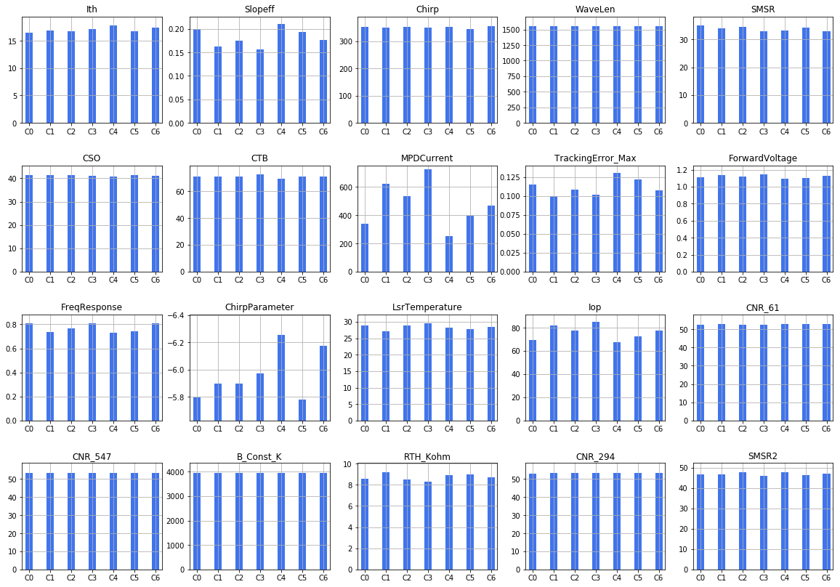
Clustering Results for Only Failed Units (without normalization)
7 Clusters
cluster 0: number of failed = 44 out of 227, Percentage = 19.38 %
cluster 1: number of failed = 24 out of 227, Percentage = 10.57 %
cluster 2: number of failed = 33 out of 227, Percentage = 14.53 %
cluster 3: number of failed = 14 out of 227, Percentage = 6.16 %
cluster 4: number of failed = 28 out of 227, Percentage = 12.33 %
cluster 5: number of failed = 40 out of 227, Percentage = 17.62 %
cluster 6: number of failed = 44 out of 227, Percentage = 19.38 %

Slide 3
Clustering Results for Only Failed Units (with normalization, mean = 0, variance=1)
7 Clusters
cluster 0: number of failed = 20 out of 227, Percentage = 8.81 %
cluster 1: number of failed = 30 out of 227, Percentage = 13.21 %
cluster 2: number of failed = 37 out of 227, Percentage = 16.29 %
cluster 3: number of failed = 42 out of 227, Percentage = 18.50 %
cluster 4: number of failed = 55 out of 227, Percentage = 24.22 %
cluster 5: number of failed = 25 out of 227, Percentage = 11.01 %
cluster 6: number of failed = 18 out of 227, Percentage = 7.92 %
 | Cluster 0 Center | Cluster 1 Center | Cluster 2 Center | Cluster 3 Center | Cluster 4 Center | Cluster 5 Center | Cluster 6 Center
Ith | 18.1970 | 16.1405 | 16.7157 | 15.6145 | 17.9462 | 19.6424 | 13.9078
Slopeff | 0.1587 | 0.1559 | 0.2231 | 0.2112 | 0.1611 | 0.2076 | 0.1698
Chirp | 342.1780 | 337.1437 | 337.3927 | 352.0298 | 365.9905 | 369.6680 | 339.4350
WaveLen | 1555.2064 | 1547.0654 | 1551.2390 | 1555.7392 | 1553.9607 | 1555.6708 | 1547.8839
SMSR | 31.0045 | 37.4350 | 34.3446 | 32.6824 | 34.0316 | 31.6816 | 37.3450
CSO | 41.7950 | 41.7933 | 42.4486 | 40.9119 | 40.1836 | 40.5040 | 41.5667
CTB | 72.0750 | 71.7533 | 70.0027 | 70.8929 | 71.8545 | 67.4000 | 70.8000
MPDCurrent | 530.6800 | 460.0733 | 406.2622 | 372.2762 | 531.8818 | 336.1480 | 455.3389
TrackingError_Max | 0.1010 | 0.0973 | 0.1170 | 0.1329 | 0.1064 | 0.1180 | 0.1139
ForwardVoltage | 1.1345 | 1.1550 | 1.0778 | 1.0857 | 1.1433 | 1.0980 | 1.1283
FreqResponse | 0.6750 | 0.7767 | 0.8405 | 0.7738 | 0.7955 | 0.6800 | 0.8000
ChirpParameter | -6.2177 | -5.4334 | -5.6286 | -5.4786 | -6.5623 | -7.2588 | -4.7184
LsrTemperature | 29.0755 | 27.7807 | 31.3446 | 26.1521 | 28.5293 | 30.8908 | 23.2383
Iop | 85.3695 | 83.5843 | 63.8151 | 65.0781 | 83.0524 | 69.1580 | 76.3678
CNR_61 | 51.6850 | 52.7467 | 52.2459 | 53.0476 | 53.1636 | 52.6040 | 52.0333
CNR_547 | 52.6950 | 53.6833 | 53.1892 | 53.7167 | 53.7873 | 52.9880 | 52.7167
B_Const_K | 3951.4850 | 3945.8267 | 3952.1351 | 3945.5119 | 3955.0018 | 3964.8160 | 3947.6056
RTH_Kohm | 8.4391 | 8.9368 | 7.6419 | 9.5663 | 8.6731 | 7.8110 | 10.8618
CNR_294 | 52.4200 | 53.7800 | 52.9000 | 53.7738 | 53.9364 | 53.1640 | 52.5333
SMSR2 | 42.8450 | 48.5387 | 47.2349 | 47.5207 | 47.3980 | 48.7220 | 43.3544

Slide 4
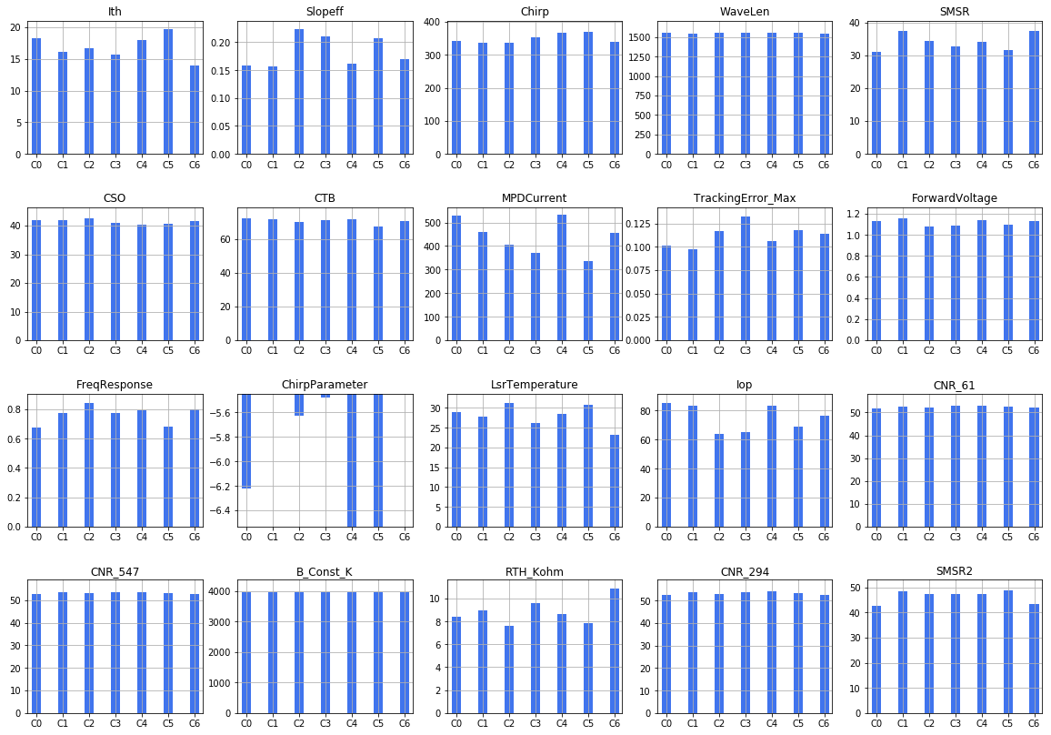
Clustering Results for Only Failed Units (with normalization, mean = 0, variance=1)
7 Clusters
cluster 0: number of failed = 20 out of 227, Percentage = 8.81 %
cluster 1: number of failed = 30 out of 227, Percentage = 13.21 %
cluster 2: number of failed = 37 out of 227, Percentage = 16.29 %
cluster 3: number of failed = 42 out of 227, Percentage = 18.50 %
cluster 4: number of failed = 55 out of 227, Percentage = 24.22 %
cluster 5: number of failed = 25 out of 227, Percentage = 11.01 %
cluster 6: number of failed = 18 out of 227, Percentage = 7.92 %

Slide 5
Clustering Results for Only Failed Units (without normalization)
5 Clusters
cluster 0: number of failed = 74 out of 227, Percentage = 32.59 %
cluster 1: number of failed = 36 out of 227, Percentage = 15.85 %
cluster 2: number of failed = 14 out of 227, Percentage = 6.16 %
cluster 3: number of failed = 67 out of 227, Percentage = 29.51 %
cluster 4: number of failed = 36 out of 227, Percentage = 15.85 %
 | Cluster 0 Center | Cluster 1 Center | Cluster 2 Center | Cluster 3 Center | Cluster 4 Center
Ith | 16.5986 | 16.8938 | 17.1199 | 17.0536 | 17.5594
Slopeff | 0.1953 | 0.1661 | 0.1557 | 0.1782 | 0.2093
Chirp | 350.2705 | 347.6031 | 349.4150 | 354.8509 | 350.1975
WaveLen | 1552.6244 | 1554.4306 | 1553.3074 | 1552.3511 | 1551.8603
SMSR | 34.3943 | 33.3175 | 32.8907 | 34.1891 | 34.0775
CSO | 41.2392 | 41.3639 | 41.0857 | 41.1030 | 41.1000
CTB | 70.9770 | 70.8167 | 72.2357 | 70.9910 | 69.5472
MPDCurrent | 369.5108 | 599.6611 | 727.4429 | 481.8194 | 264.9639
TrackingError_Max | 0.1235 | 0.1117 | 0.1021 | 0.1009 | 0.1208
ForwardVoltage | 1.1077 | 1.1308 | 1.1407 | 1.1225 | 1.1000
FreqResponse | 0.7757 | 0.7472 | 0.8107 | 0.7910 | 0.7472
ChirpParameter | -5.8268 | -5.8729 | -5.9719 | -6.0510 | -6.1503
LsrTemperature | 28.3393 | 27.3772 | 29.5521 | 28.7164 | 28.1200
Iop | 71.0786 | 81.0364 | 84.8514 | 77.1225 | 68.0153
CNR_61 | 52.7041 | 52.5528 | 52.4786 | 52.6552 | 52.7306
CNR_547 | 53.3378 | 53.4111 | 53.4786 | 53.4463 | 53.3611
B_Const_K | 3949.3095 | 3948.0833 | 3960.0286 | 3953.8522 | 3953.3056
RTH_Kohm | 8.7567 | 9.1098 | 8.2995 | 8.6230 | 8.8708
CNR_294 | 53.3054 | 53.3556 | 53.3857 | 53.5463 | 53.2889
SMSR2 | 46.3818 | 46.7117 | 46.1650 | 47.5699 | 47.6272

Slide 6
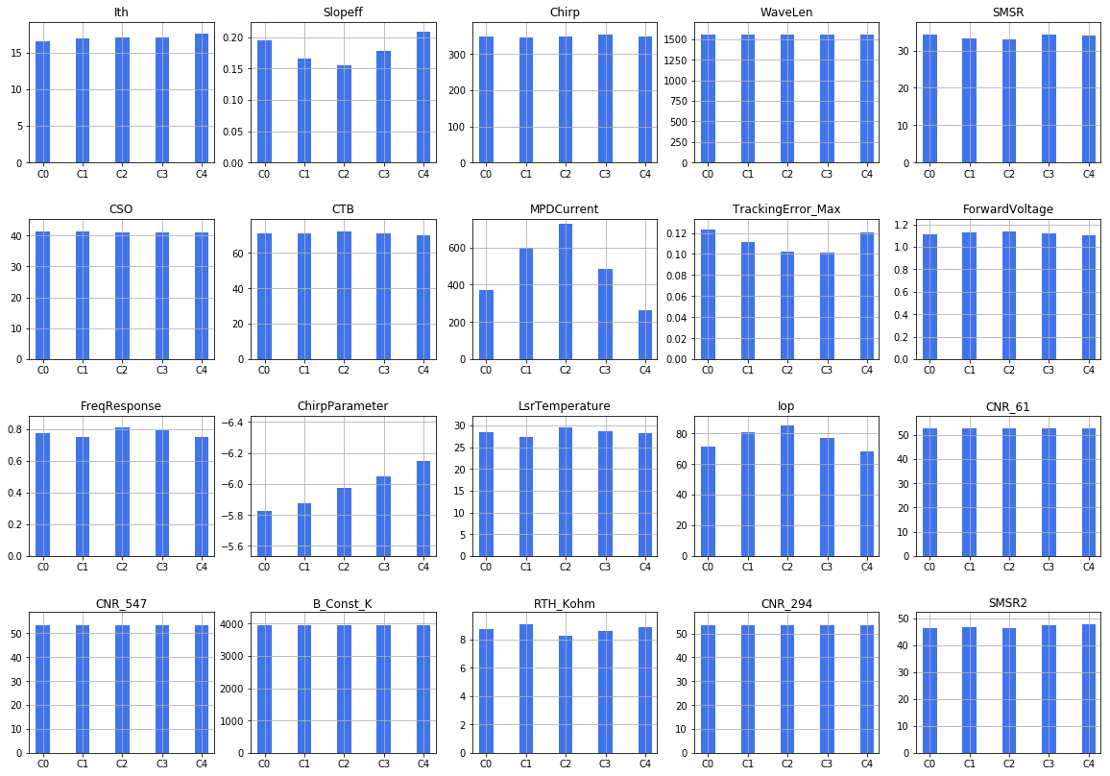
Clustering Results for Only Failed Units (without normalization)
5 Clusters
cluster 0: number of failed = 74 out of 227, Percentage = 32.59 %
cluster 1: number of failed = 36 out of 227, Percentage = 15.85 %
cluster 2: number of failed = 14 out of 227, Percentage = 6.16 %
cluster 3: number of failed = 67 out of 227, Percentage = 29.51 %
cluster 4: number of failed = 36 out of 227, Percentage = 15.85 %

Slide 7
Clustering Results for Only Failed Units (with normalization, mean = 0, variance=1)
5 Clusters
cluster 0: number of failed = 27 out of 227, Percentage = 11.89 %
cluster 1: number of failed = 65 out of 227, Percentage = 28.63 %
cluster 2: number of failed = 47 out of 227, Percentage = 20.70 %
cluster 3: number of failed = 46 out of 227, Percentage = 20.26 %
cluster 4: number of failed = 42 out of 227, Percentage = 18.50 %
 | Cluster 0 Center | Cluster 1 Center | Cluster 2 Center | Cluster 3 Center | Cluster 4 Center
Ith | 13.6126 | 16.9606 | 15.8478 | 18.1153 | 19.1132
Slopeff | 0.1879 | 0.1500 | 0.2131 | 0.2142 | 0.1758
Chirp | 336.3863 | 349.1538 | 351.0609 | 344.2857 | 371.2674
WaveLen | 1544.7511 | 1552.0470 | 1555.7944 | 1554.7002 | 1553.4434
SMSR | 37.7937 | 34.2620 | 33.1385 | 32.9974 | 33.3260
CSO | 42.0111 | 41.1831 | 40.8681 | 41.9978 | 40.1333
CTB | 70.8037 | 71.9938 | 70.8489 | 69.8326 | 69.9905
MPDCurrent | 441.7704 | 524.4154 | 373.5638 | 399.5152 | 452.0571
TrackingError_Max | 0.1033 | 0.0935 | 0.1319 | 0.1243 | 0.1169
ForwardVoltage | 1.1141 | 1.1466 | 1.0877 | 1.0859 | 1.1376
FreqResponse | 0.7926 | 0.7708 | 0.7830 | 0.7891 | 0.7369
ChirpParameter | -4.5706 | -5.9078 | -5.5487 | -6.2377 | -7.0930
LsrTemperature | 24.9489 | 27.8037 | 26.1887 | 31.7146 | 30.0510
Iop | 70.8963 | 86.8486 | 64.8255 | 66.9967 | 78.4000
CNR_61 | 51.9926 | 52.6338 | 53.0277 | 52.2087 | 53.1905
CNR_547 | 52.9185 | 53.4462 | 53.7447 | 52.9022 | 53.7643
B_Const_K | 3949.7556 | 3947.7800 | 3945.1426 | 3955.5217 | 3962.4429
RTH_Kohm | 10.1153 | 8.9263 | 9.5547 | 7.5214 | 8.1155
CNR_294 | 52.7000 | 53.5062 | 53.8021 | 52.6978 | 53.9333
SMSR2 | 45.7326 | 45.5363 | 48.1019 | 46.6120 | 49.1038

Slide 8
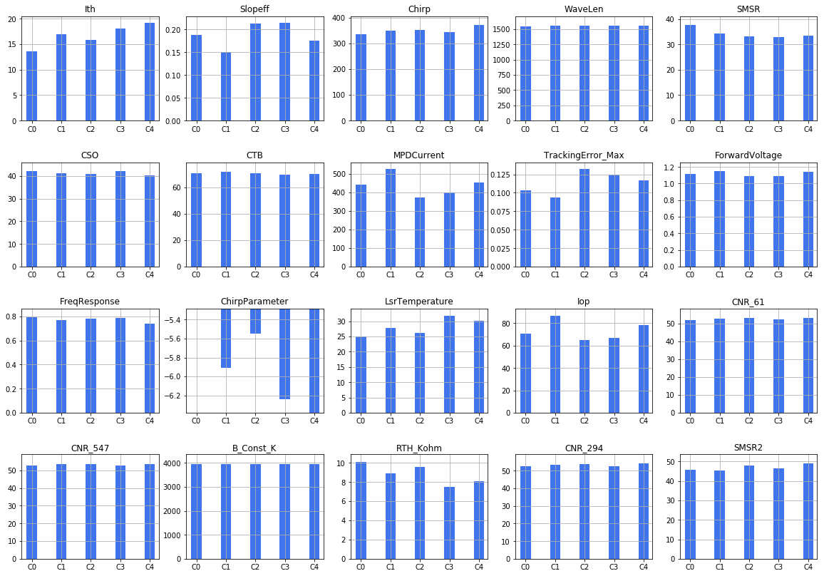
Clustering Results for Only Failed Units (with normalization, mean = 0, variance=1)
5 Clusters
cluster 0: number of failed = 27 out of 227, Percentage = 11.89 %
cluster 1: number of failed = 65 out of 227, Percentage = 28.63 %
cluster 2: number of failed = 47 out of 227, Percentage = 20.70 %
cluster 3: number of failed = 46 out of 227, Percentage = 20.26 %
cluster 4: number of failed = 42 out of 227, Percentage = 18.50 %

Slide 9
Clustering Results for Only Failed Units (without normalization)
3 Clusters
cluster 0: number of failed = 38 out of 227, Percentage = 16.74 %
cluster 1: number of failed = 103 out of 227, Percentage = 45.37 %
cluster 2: number of failed = 86 out of 227, Percentage = 37.88 %
 | Cluster 0 Center | Cluster 1 Center | Cluster 2 Center
Ith | 16.9620 | 16.8619 | 17.0878
Slopeff | 0.1605 | 0.2012 | 0.1774
Chirp | 349.4626 | 350.2344 | 352.9528
WaveLen | 1553.8269 | 1552.2912 | 1552.8266
SMSR | 33.6179 | 34.3811 | 33.7652
CSO | 41.1632 | 41.1903 | 41.1942
CTB | 71.4684 | 70.5398 | 70.8337
MPDCurrent | 660.8526 | 330.0252 | 486.4116
TrackingError_Max | 0.1008 | 0.1233 | 0.1066
ForwardVoltage | 1.1374 | 1.1045 | 1.1219
FreqResponse | 0.7645 | 0.7689 | 0.7826
ChirpParameter | -5.9257 | -5.9127 | -6.0333
LsrTemperature | 28.0429 | 28.2966 | 28.5181
Iop | 83.1558 | 69.5432 | 77.4179
CNR_61 | 52.5868 | 52.7350 | 52.5919
CNR_547 | 53.4421 | 53.3631 | 53.4093
B_Const_K | 3953.5868 | 3950.6330 | 3952.2779
RTH_Kohm | 8.8831 | 8.7840 | 8.6852
CNR_294 | 53.3895 | 53.3194 | 53.4663
SMSR2 | 46.4411 | 46.7898 | 47.4166

Slide 10
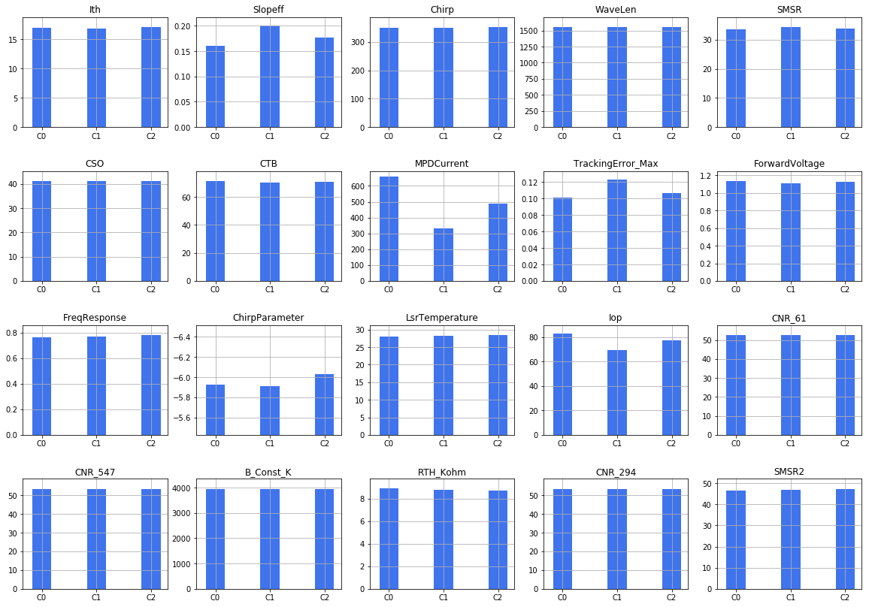
Clustering Results for Only Failed Units (without normalization)
3 Clusters
cluster 0: number of failed = 38 out of 227, Percentage = 16.74 %
cluster 1: number of failed = 103 out of 227, Percentage = 45.37 %
cluster 2: number of failed = 86 out of 227, Percentage = 37.88 %

Slide 11
Clustering Results for Only Failed Units (with normalization, mean = 0, variance=1)
3 Clusters
cluster 0: number of failed = 74 out of 227, Percentage = 32.59 %
cluster 1: number of failed = 91 out of 227, Percentage = 40.08 %
cluster 2: number of failed = 62 out of 227, Percentage = 27.31 %
 | Cluster 0 Center | Cluster 1 Center | Cluster 2 Center
Ith | 14.9042 | 18.0142 | 17.8819
Slopeff | 0.1963 | 0.1592 | 0.2107
Chirp | 344.1612 | 359.1152 | 347.7460
WaveLen | 1551.9204 | 1552.7947 | 1553.6786
SMSR | 34.2772 | 34.3919 | 33.1673
CSO | 41.3635 | 40.5923 | 41.8500
CTB | 70.9500 | 71.4802 | 69.6468
MPDCurrent | 413.9162 | 497.9275 | 403.1484
TrackingError_Max | 0.1157 | 0.1076 | 0.1185
ForwardVoltage | 1.1004 | 1.1484 | 1.0892
FreqResponse | 0.7824 | 0.7753 | 0.7597
ChirpParameter | -5.1196 | -6.4675 | -6.2201
LsrTemperature | 25.4466 | 28.5862 | 31.4250
Iop | 69.1865 | 84.0867 | 67.8890
CNR_61 | 52.6622 | 52.9396 | 52.2323
CNR_547 | 53.4730 | 53.6571 | 52.9129
B_Const_K | 3946.5000 | 3952.4198 | 3957.0355
RTH_Kohm | 9.8768 | 8.6365 | 7.6197
CNR_294 | 53.4122 | 53.7637 | 52.8032
SMSR2 | 46.4285 | 47.7245 | 46.5048

Slide 12
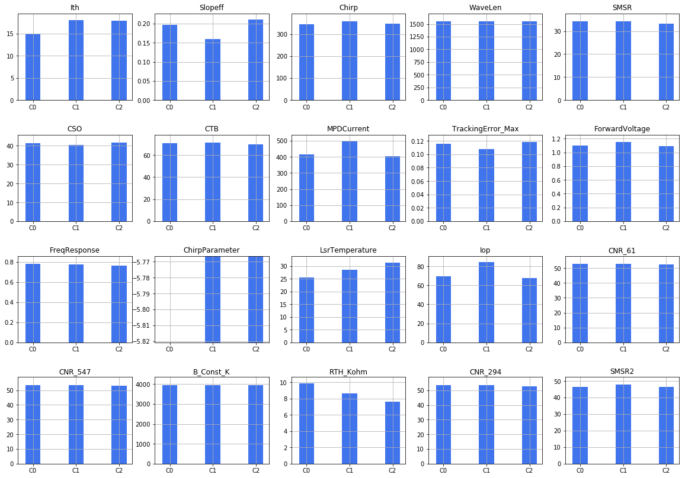
Clustering Results for Only Failed Units (with normalization, mean = 0, variance=1)
3 Clusters
cluster 0: number of failed = 74 out of 227, Percentage = 32.59 %
cluster 1: number of failed = 91 out of 227, Percentage = 40.08 %
cluster 2: number of failed = 62 out of 227, Percentage = 27.31 %

Slide 13
Clustering Results for Only Failed Units (without normalization)
2 Clusters
cluster 0: number of failed = 92 out of 227, Percentage = 40.52 %
cluster 1: number of failed = 135 out of 227, Percentage = 59.47 %
 | Cluster 0 Center | Cluster 1 Center
Ith | 17.0779 | 16.8868
Slopeff | 0.1680 | 0.1972
Chirp | 350.6008 | 351.4992
WaveLen | 1553.5785 | 1552.1872
SMSR | 34.0967 | 33.9677
CSO | 41.2337 | 41.1556
CTB | 71.2380 | 70.5126
MPDCurrent | 574.0065 | 356.5022
TrackingError_Max | 0.1036 | 0.1198
ForwardVoltage | 1.1314 | 1.1064
FreqResponse | 0.7864 | 0.7644
ChirpParameter | -5.9860 | -5.9432
LsrTemperature | 28.4062 | 28.2916
Iop | 80.5776 | 70.8716
CNR_61 | 52.5630 | 52.7193
CNR_547 | 53.4348 | 53.3659
B_Const_K | 3952.7217 | 3951.0889
RTH_Kohm | 8.7393 | 8.7794
CNR_294 | 53.4174 | 53.3659
SMSR2 | 47.1166 | 46.8682

Slide 14
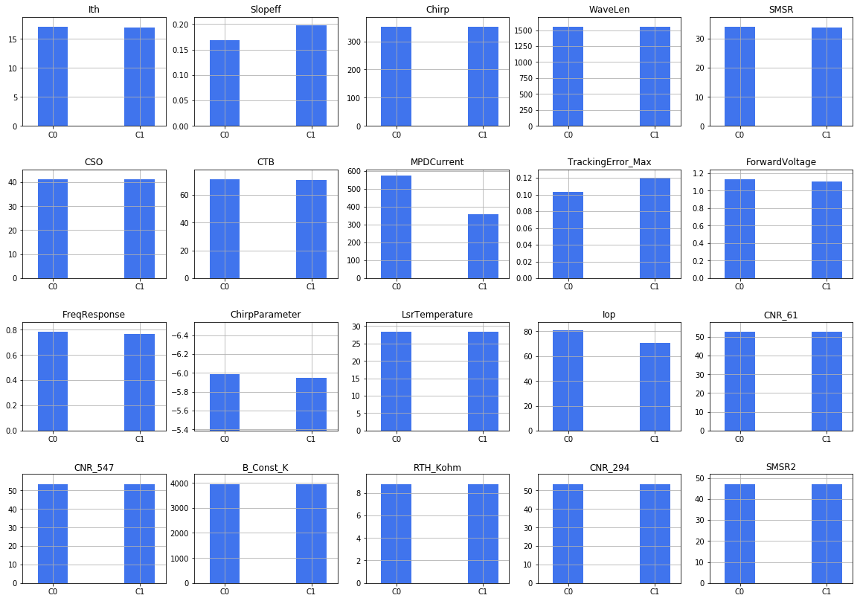
Clustering Results for Only Failed Units (without normalization)
2 Clusters
cluster 0: number of failed = 92 out of 227, Percentage = 40.52 %
cluster 1: number of failed = 135 out of 227, Percentage = 59.47 %

Slide 15
Clustering Results for Only Failed Units (with normalization, mean = 0, variance=1)
2 Clusters
cluster 0: number of failed = 106 out of 227, Percentage = 46.69 %
cluster 1: number of failed = 121 out of 227, Percentage = 53.30 %
 | Cluster 0 Center | Cluster 1 Center
Ith | 16.2729 | 17.5699
Slopeff | 0.2149 | 0.1595
Chirp | 344.5871 | 356.8713
WaveLen | 1553.1536 | 1552.3985
SMSR | 33.7571 | 34.2503
CSO | 41.6575 | 40.7752
CTB | 70.0377 | 71.4802
MPDCurrent | 387.4000 | 494.8099
TrackingError_Max | 0.1208 | 0.1066
ForwardVoltage | 1.0843 | 1.1448
FreqResponse | 0.7887 | 0.7599
ChirpParameter | -5.6083 | -6.2691
LsrTemperature | 28.5921 | 28.1155
Iop | 64.9279 | 83.4583
CNR_61 | 52.4896 | 52.8017
CNR_547 | 53.2264 | 53.5405
B_Const_K | 3952.1217 | 3951.4256
RTH_Kohm | 8.6830 | 8.8333
CNR_294 | 53.1877 | 53.5612
SMSR2 | 47.2178 | 46.7508

Slide 16
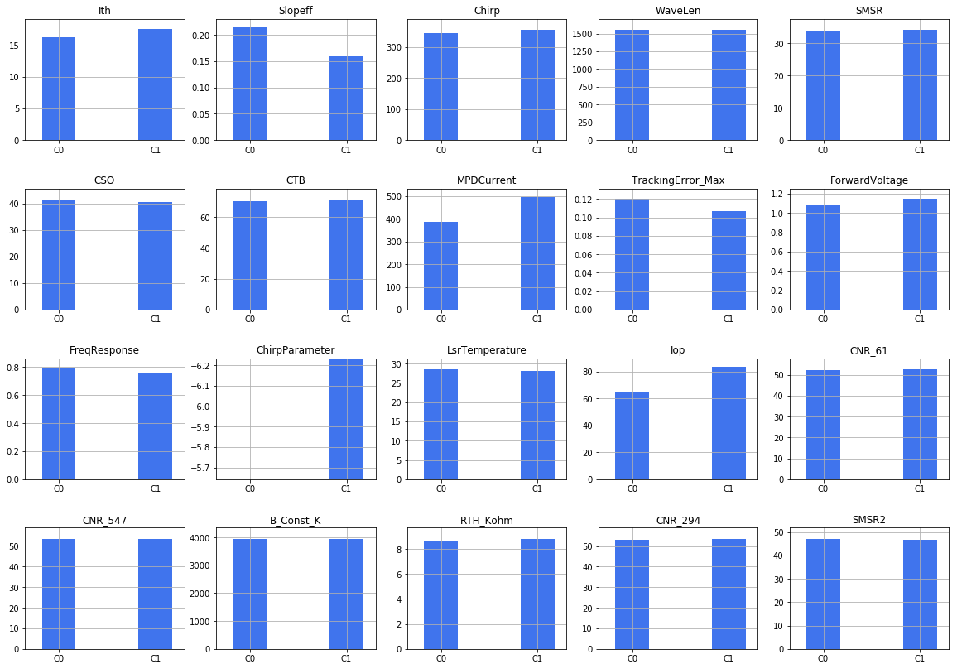
Clustering Results for Only Failed Units (with normalization, mean = 0, variance=1)
2 Clusters
cluster 0: number of failed = 106 out of 227, Percentage = 46.69 %
cluster 1: number of failed = 121 out of 227, Percentage = 53.30 %

